Slide 1









Train & Test Dataset
JSON Serialize
GeoPandas
Manual Data Cleaning
LSTM
USA Census
XAI GROK
Power Bi

Slide 2
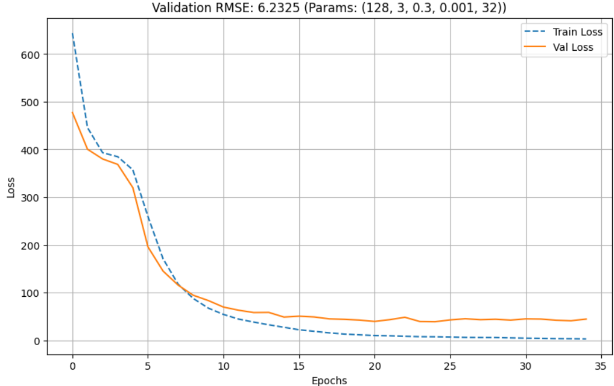
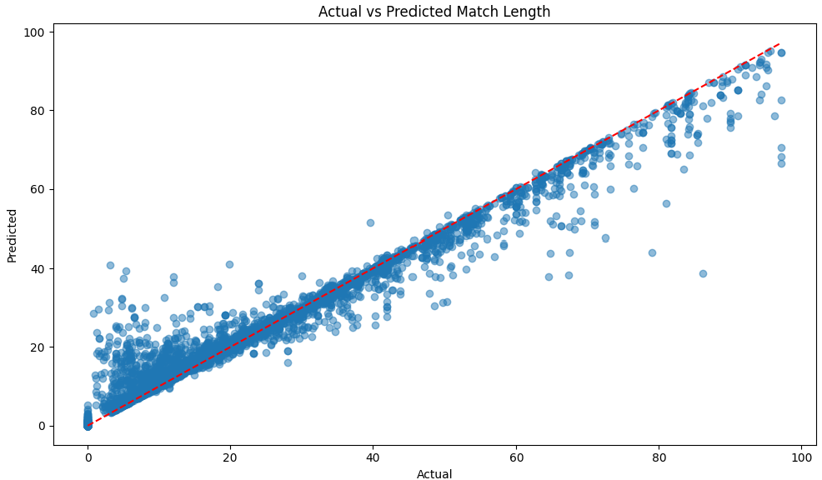
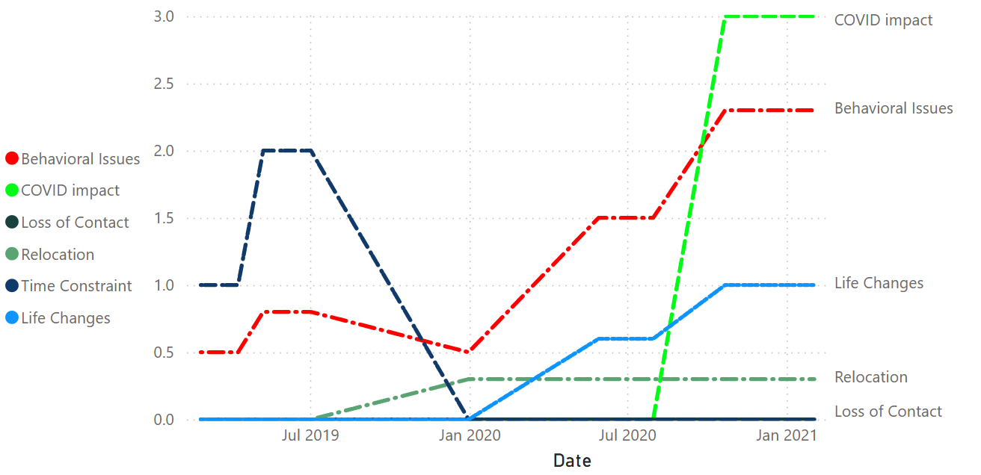
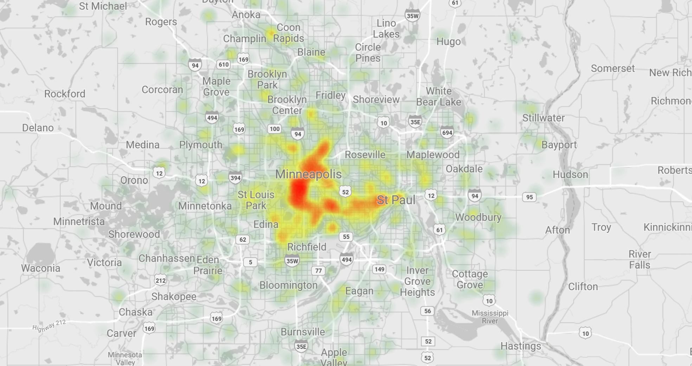

Pipeline Overview
Model Prediction
LSTM (Deep Learning)
Train Dataset
Data & Alert Driven Decision
Test Dataset
Manual Data Cleaning
Power Bi
XAI GROK
(Event Detection)
External Data
Research Papers
GeoPandas
USA Census
BBB
Google Scholar
Data Producers
Data Processing Pipeline
Data Consumers

Slide 3



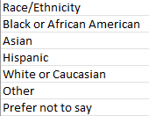
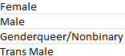
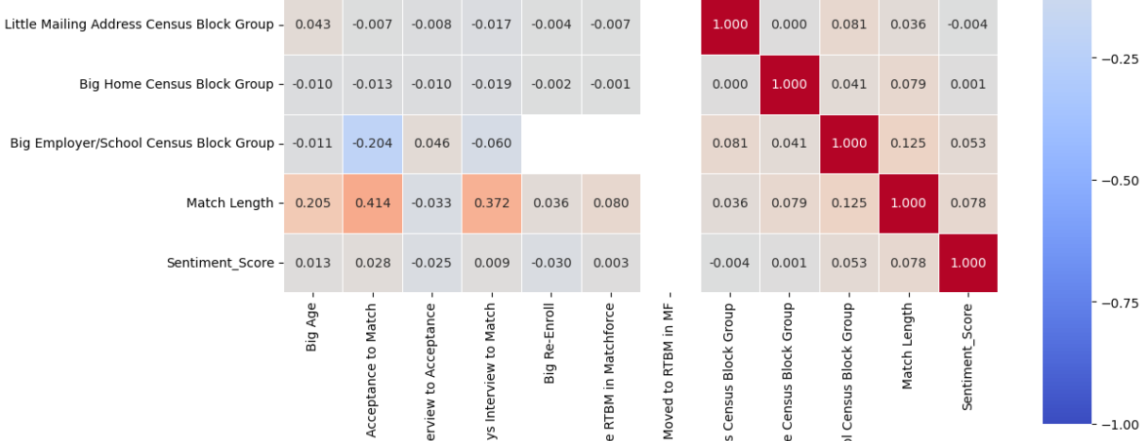
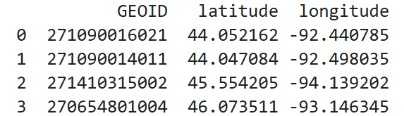
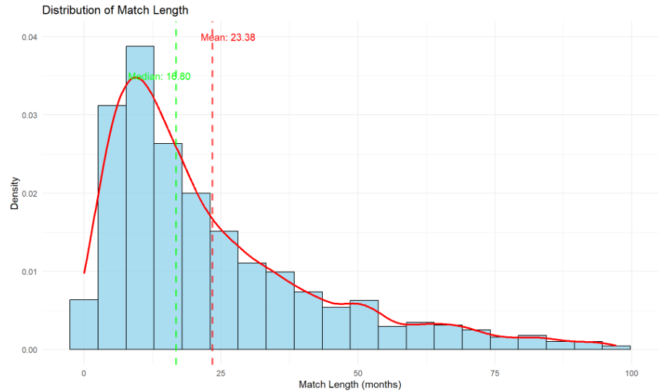
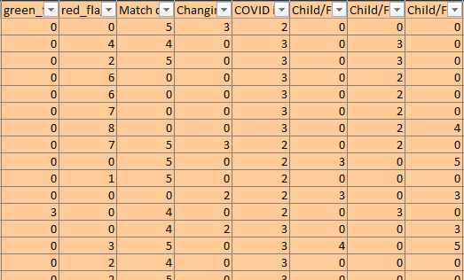
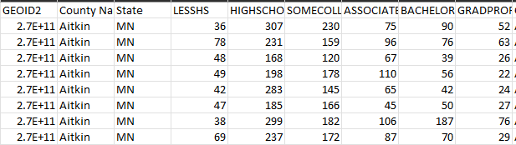
Manual Processing
Match Length Stats Analysis with Pandas:
Correlation
Standard Deviation
Outliers
Closure Seasons
Recategorization of categories to reduce category Count:
Gender
Race
Education Level
Occupation
Extract centroid (Latitude, Longitude) From .shp files for each census block.
- Adds Distance Value between Big and Small
GeoPandas
GeoPandas
Transformation of nested Temporal Features into column Features for LSTM Training.
Impute/Add missing Columns:
Education
Mean / Median Income
Race
USA Census

Slide 4


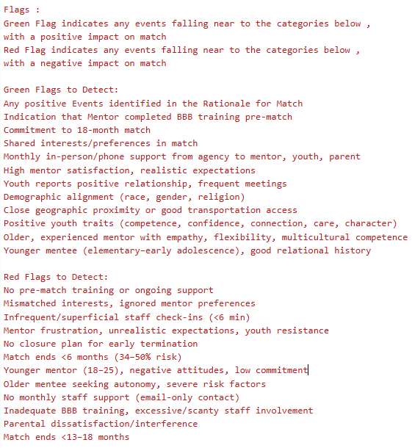
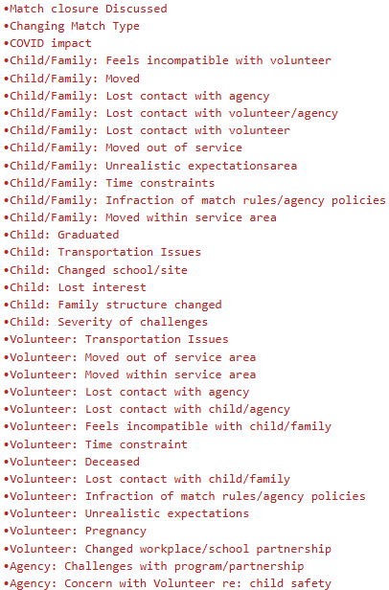
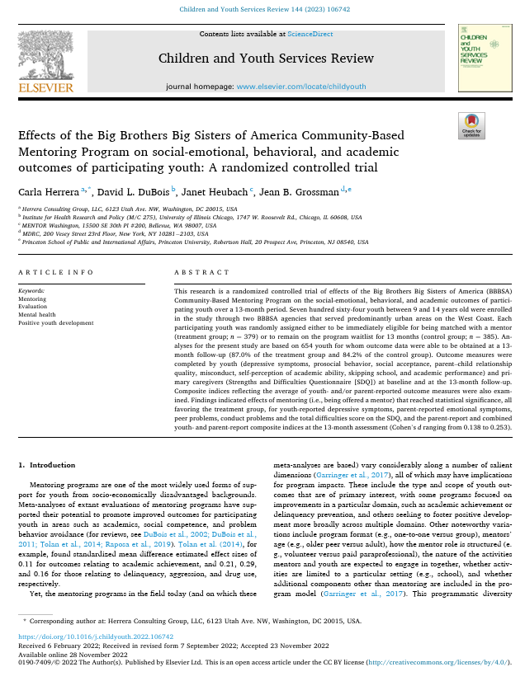

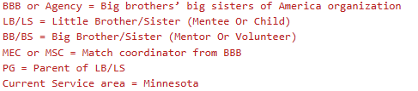
Prompt Context
Research Papers
Context Prompt Green / Red Flags (Cached Context)
Context Prompt Negative Events
(Cached Context)
BBB
Google Scholar

Slide 5

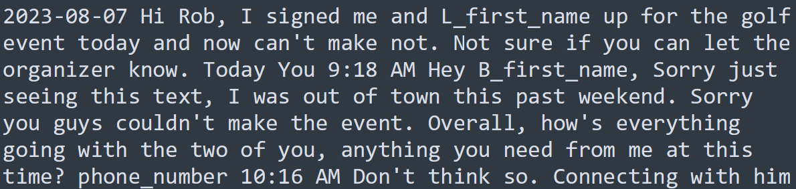
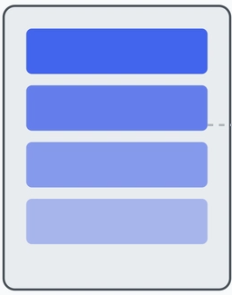
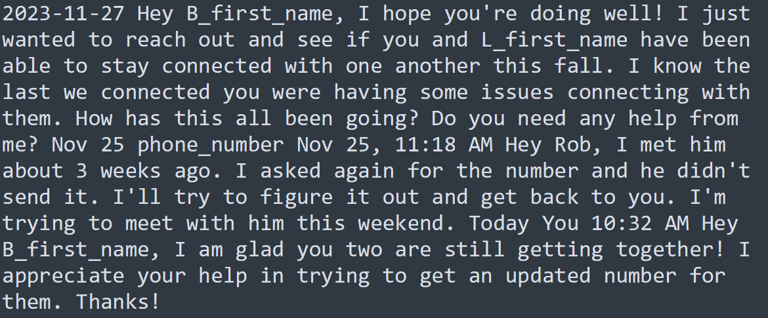
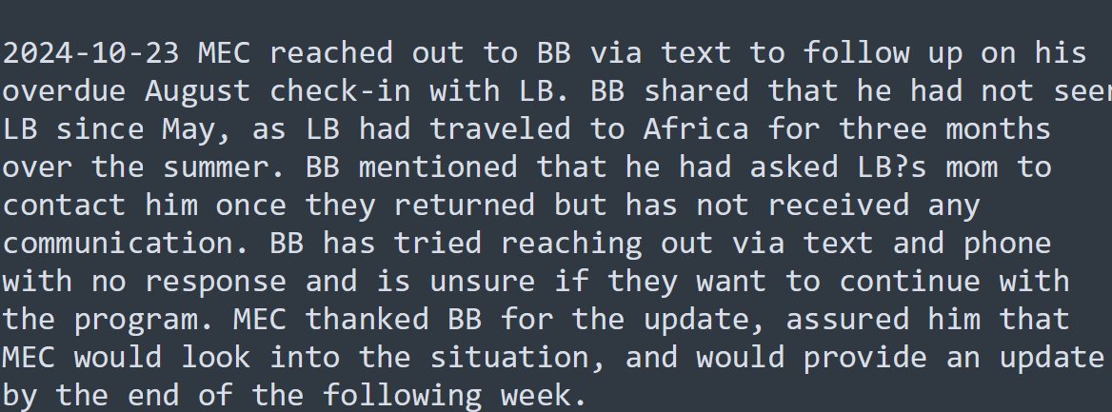

Grok Query Structure
Monthly Volunteer Mentor Catchup Notes
Output Format Prompt
Context Cache Optimization to reduce input token count
Context Information (Flags & Events)
Match Rational Notes, events mentioned here doubles the green flag count

Slide 6
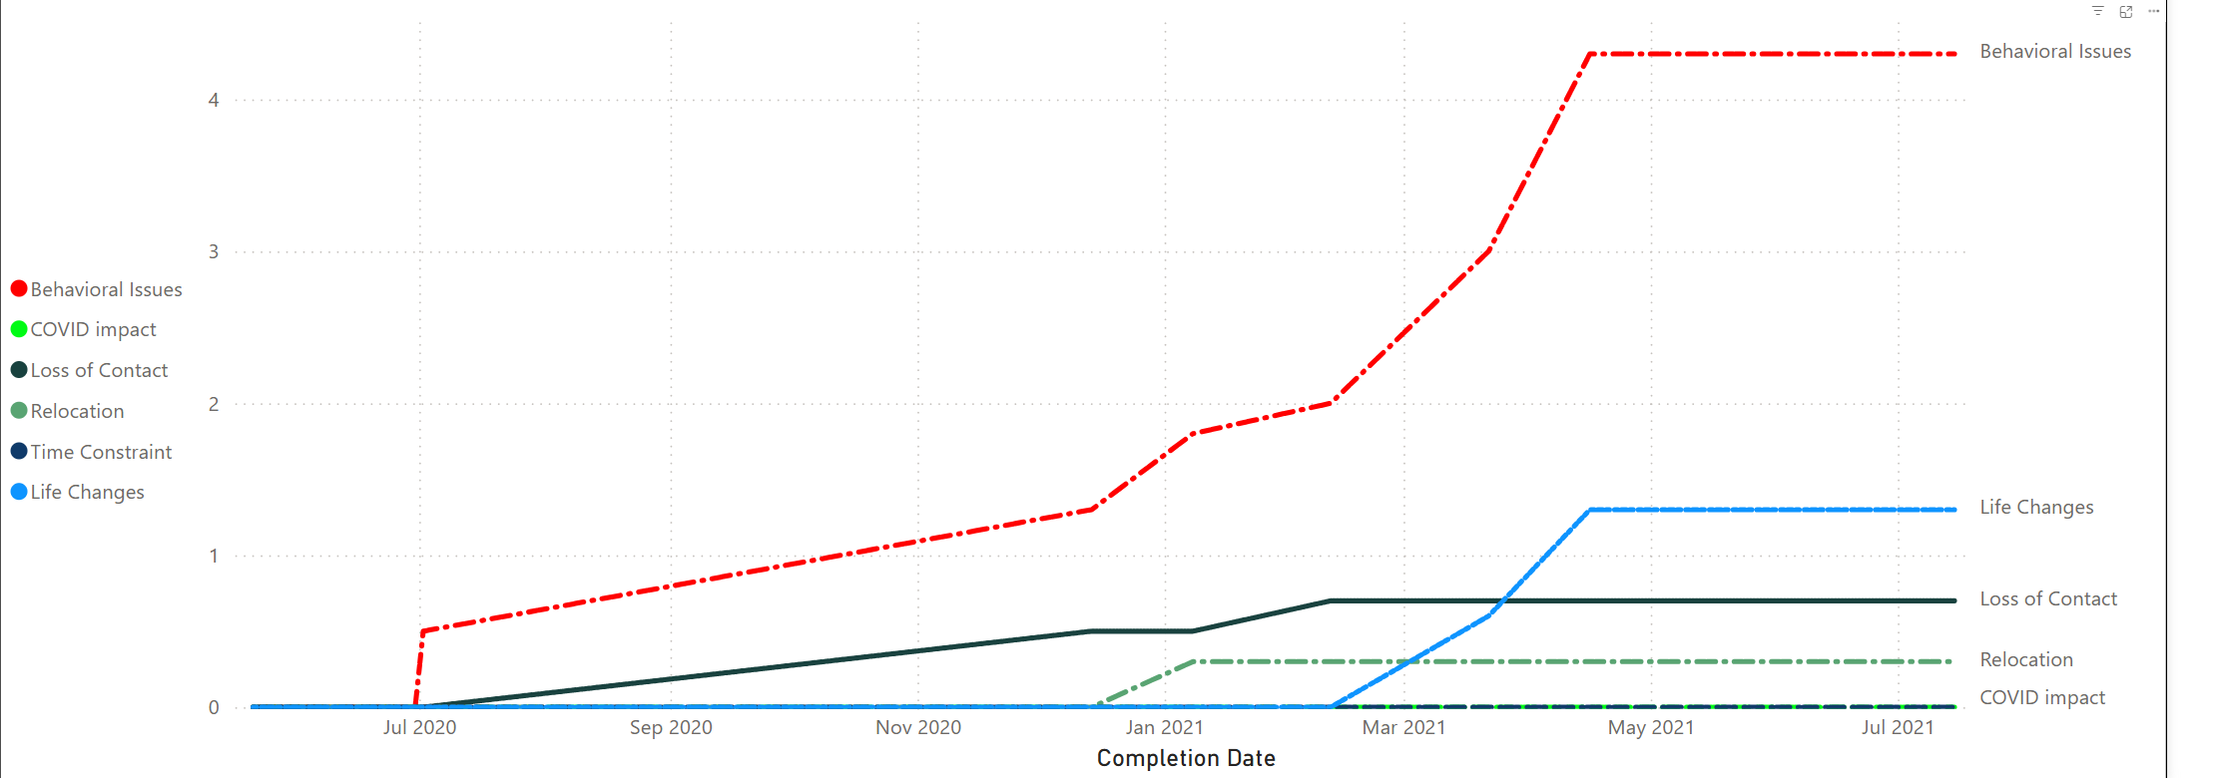
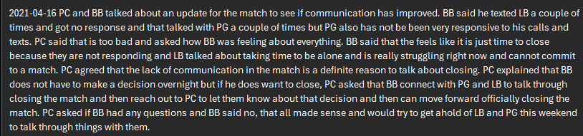
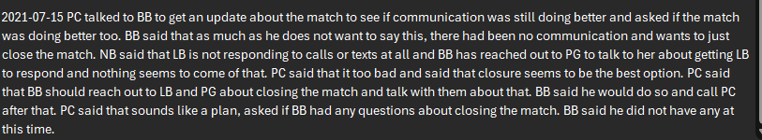
Match ID: a1v2J000003AOnYQAW

Slide 7
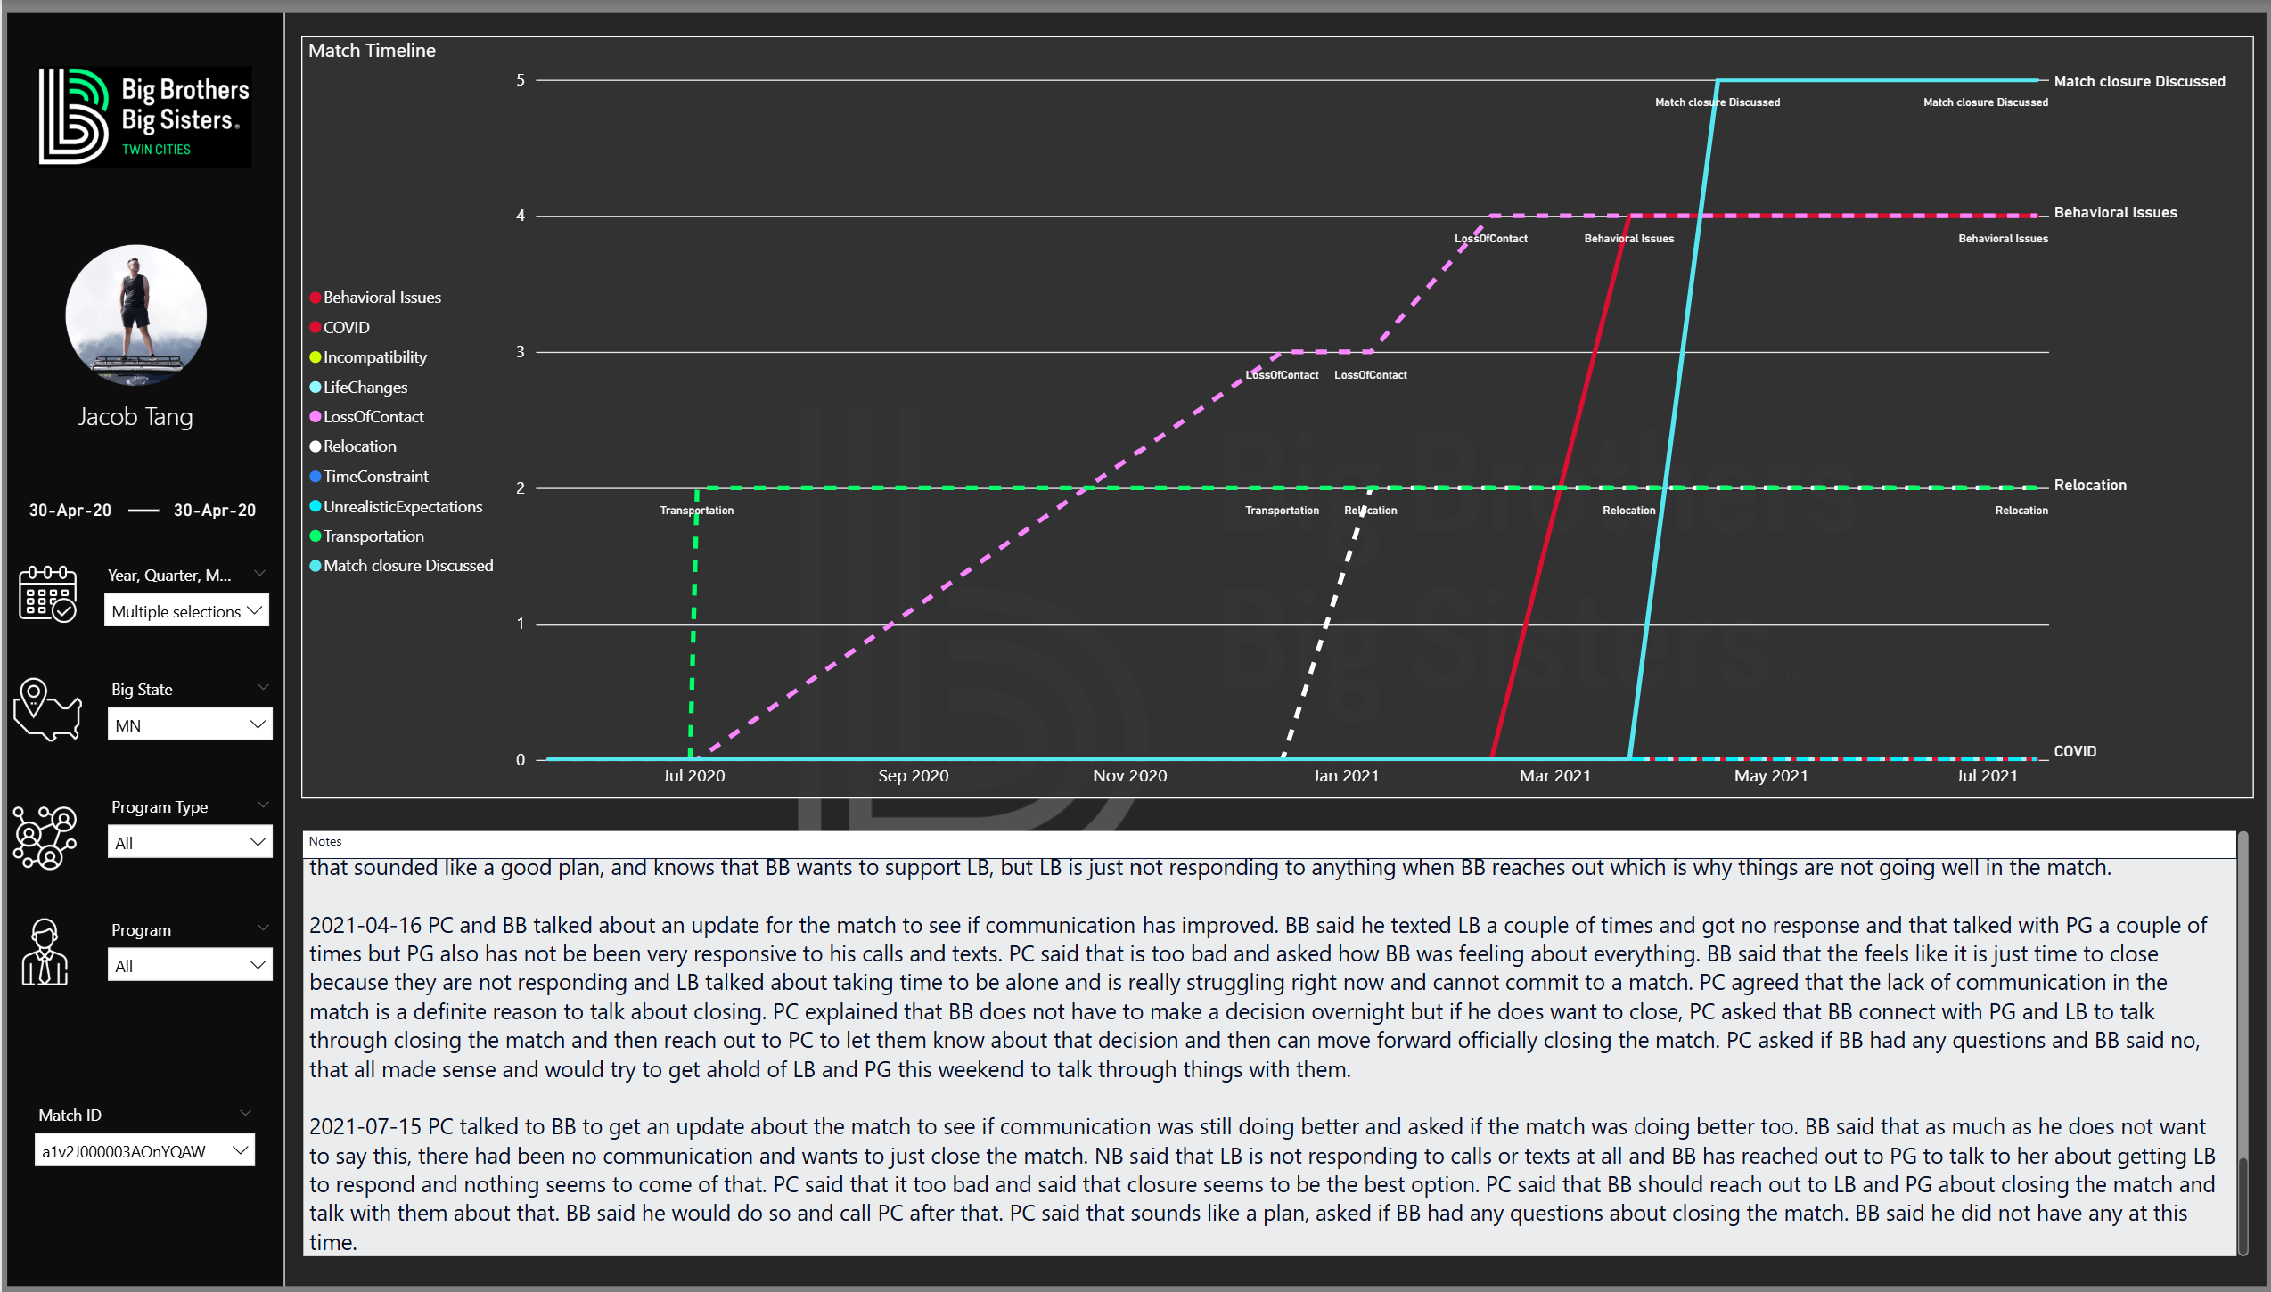

Slide 8
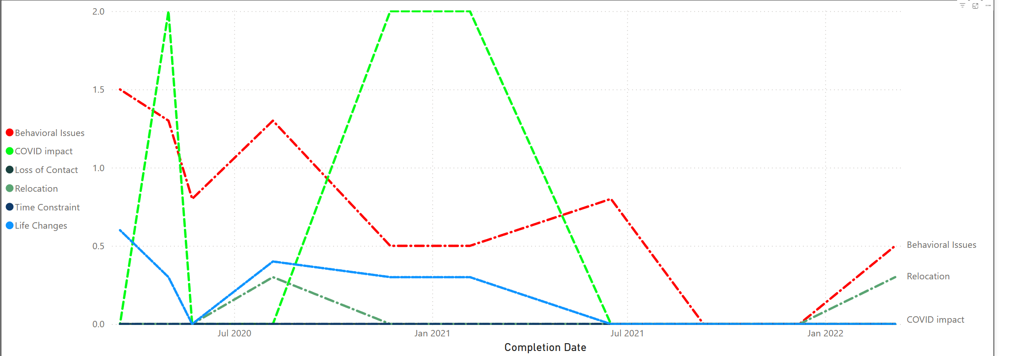
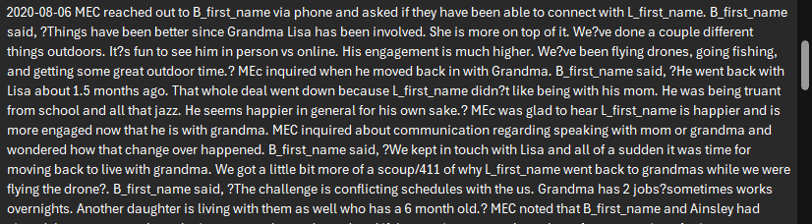
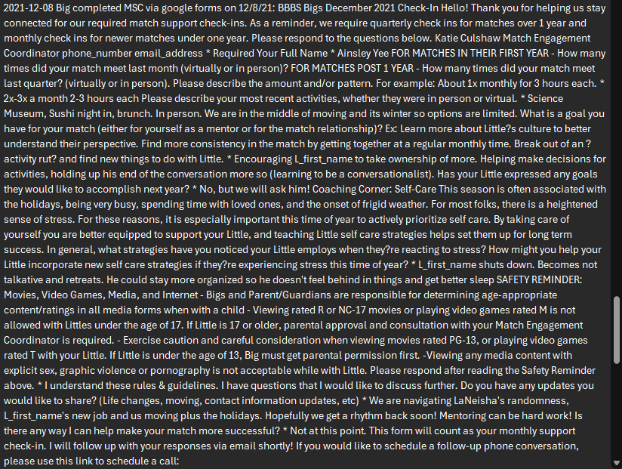
MatchId:a1v2J000002ug91QAA

Slide 9
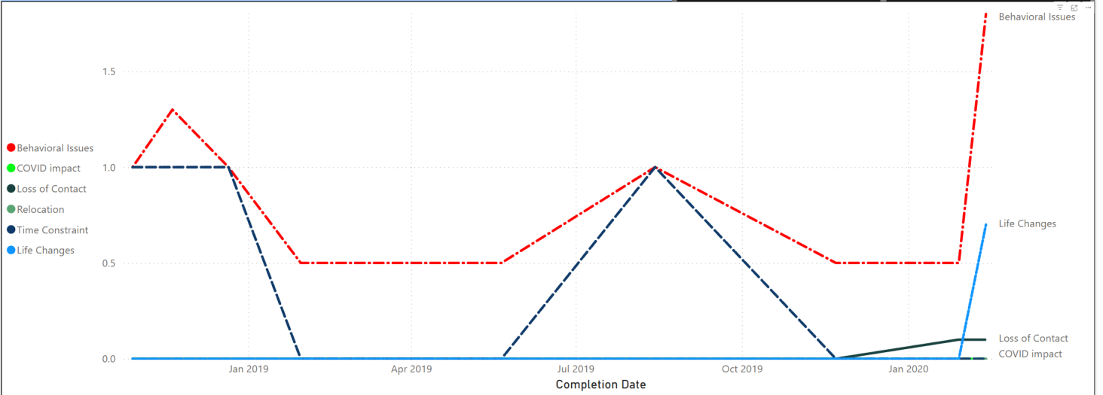
Match ID: a1v2J0000027dBaQAI
BS did say that she’s hoping to attend the Winter Picnic, but still has not reached P/G.
MEC isn’t sure the future of this match as BS seems frustrated and disheartened in the lack of engagement, enthusiasm and communication from P/G.
BS cannot commit their time to the match anymore due to family matters, and is looking to close. BS had talked to PG, and they’re in agreement about the match closing. They’re working together to find the healthiest closure option for LS

Slide 10
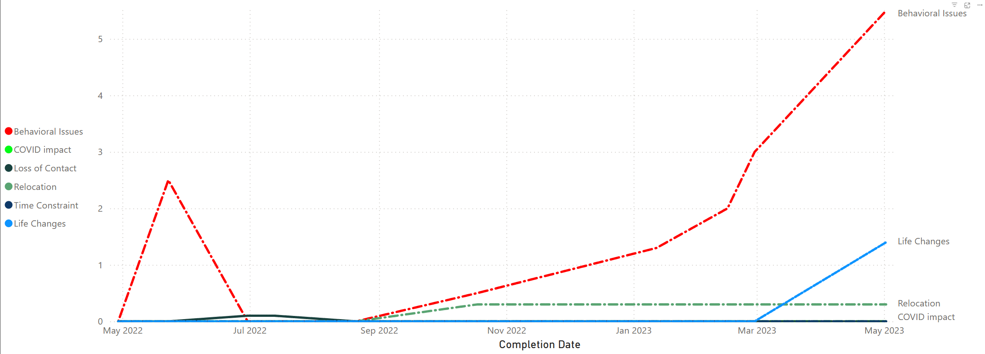
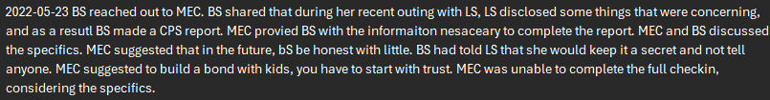
MatchID: a1v2J000003LH2lQAG
Big contacted the Match Engagement Coordinator to request match closure, explaining that she was pregnant and had been severely ill for two months, preventing her from seeing her Little (Nariah) since their last conversation.
Big said she "no longer feels she is getting anything out of it". MEC aknowledged her feelings and asked her to consider the benefits that Little is getting from the relationship and if she feels that is important. Big said she feels really guilty but she no longer wants to support Little if she isn't willing to at the minimum meet her with a match goal.

